Slide 1
A PROGRAM OF THE LINCOLN PARK TRIXIE SOCIETY
THE DATA CENTER
INITIATIVE
Massive data centers, tastefully elsewhere.
Office of the Committee · Village Distribution Only
Notes:
Lincoln Park Trixie Society Data Center Initiative. Current twelve-site register and service copy, October 2026. Site details: https://lptrixie-site.netlify.app/datacenters/the-perimeter.html . Municipal outline source: https://data.cityofchicago.org/resource/qqq8-j68g.geojson . Real locality coordinates: U.S. Census Gazetteer 2025. Map is schematic. Current package does not make new measured latency or capacity claims.

Slide 2
THE POSITION
No data centers in the Village. A fully served Village.
0
12
2
data centers permitted in 60614. The campaign continues; the file on the basements remains open.
faraway sites on the Regional Compute Perimeter. The Village receives the service. Someone else receives the hum.
LPTS sites: Peat Bog Junction (primary) and Sparrow Ditch (secondary). Four of the racks are pink.
Computation is essential. It happens where we cannot hear it.
Notes:
Lincoln Park Trixie Society Data Center Initiative. Current twelve-site register and service copy, October 2026. Site details: https://lptrixie-site.netlify.app/datacenters/the-perimeter.html . Municipal outline source: https://data.cityofchicago.org/resource/qqq8-j68g.geojson . Real locality coordinates: U.S. Census Gazetteer 2025. Map is schematic. Current package does not make new measured latency or capacity claims.

Slide 3
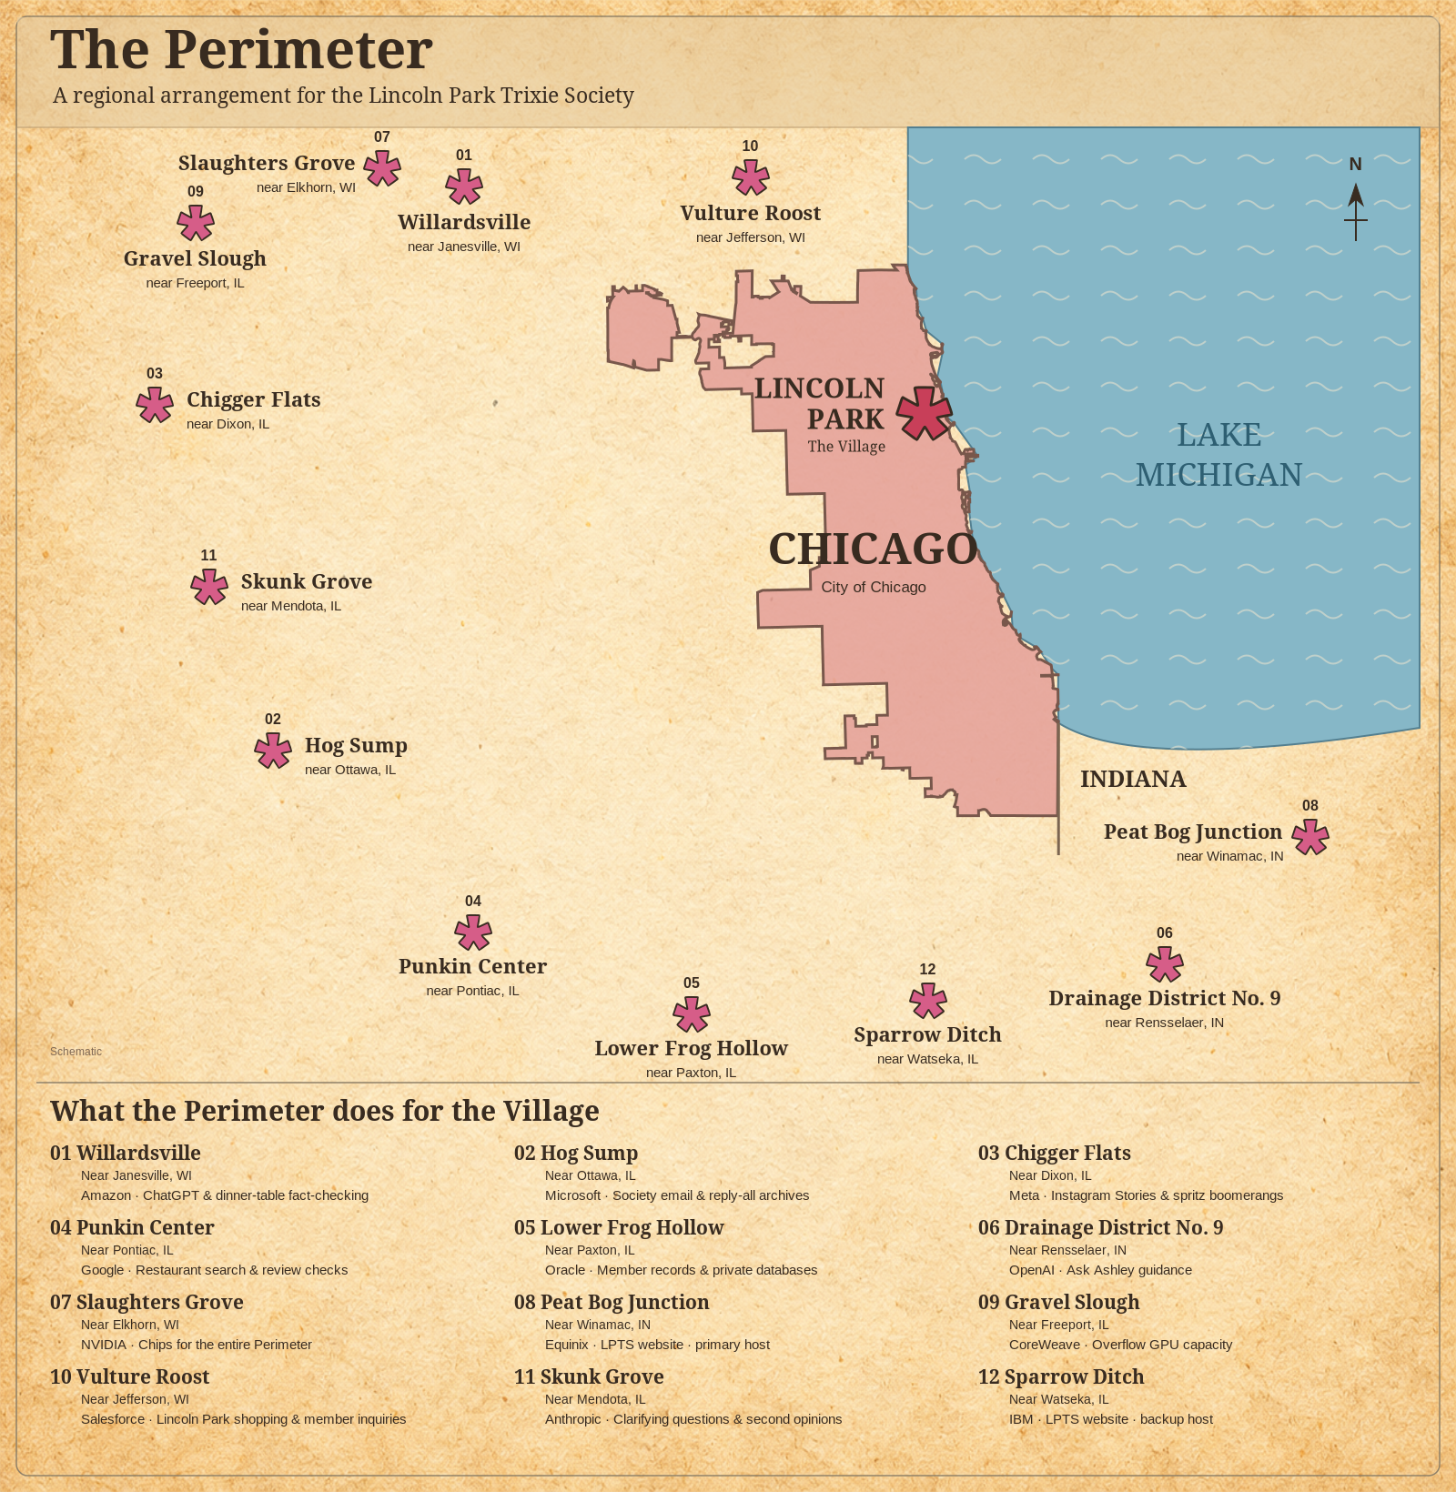
THE REGIONAL COMPUTE PERIMETER
Twelve sites.
One Village.
Lincoln Park remains the center of the arrangement.
The full map and service register accompany the site dossiers.
Notes:
Lincoln Park Trixie Society Data Center Initiative. Current twelve-site register and service copy, October 2026. Site details: https://lptrixie-site.netlify.app/datacenters/the-perimeter.html . Municipal outline source: https://data.cityofchicago.org/resource/qqq8-j68g.geojson . Real locality coordinates: U.S. Census Gazetteer 2025. Map is schematic. Current package does not make new measured latency or capacity claims.

Slide 4
THE SITES
The daily essentials
1. Willardsville
2. Hog Sump
Near Janesville, WI
Near Ottawa, IL
Amazon: ChatGPT & dinner-table fact-checking
Microsoft: Society email & reply-all archives
Fact-checks the outrageous dinner claim before the reservation.
Produces the original invitation before anyone says she was never told.
3. Chigger Flats
4. Punkin Center
Near Dixon, IL
Near Pontiac, IL
Meta: Instagram Stories & spritz boomerangs
Google: Restaurant search & review checks
Posts the market purchase while the tote is still on the shoulder.
Checks the restaurant before the valet takes the keys.
5. Lower Frog Hollow
6. Drainage District No. 9
Near Paxton, IL
Near Rensselaer, IN
Oracle: Member records & private databases
OpenAI: Ask Ashley guidance
Retrieves membership records. The invoice explanation remains sealed.
Keeps Ask Ashley available before a Member makes the situation worse.
Notes:
Lincoln Park Trixie Society Data Center Initiative. Current twelve-site register and service copy, October 2026. Site details: https://lptrixie-site.netlify.app/datacenters/the-perimeter.html . Municipal outline source: https://data.cityofchicago.org/resource/qqq8-j68g.geojson . Real locality coordinates: U.S. Census Gazetteer 2025. Map is schematic. Current package does not make new measured latency or capacity claims.

Slide 5
THE SITES
The Village support staff
7. Slaughters Grove
8. Peat Bog Junction
Near Elkhorn, WI
Near Winamac, IN
NVIDIA: Chips for the entire Perimeter
Equinix: LPTS website · primary host
Supplies the chips behind the Perimeter’s service to the Village.
Keeps the Society website, notices and member reading available.
9. Gravel Slough
10. Vulture Roost
Near Freeport, IL
Near Jefferson, WI
CoreWeave: Overflow GPU capacity
Salesforce: Lincoln Park shopping & member inquiries
Adds computing room when Village demand overruns ordinary capacity.
Keeps Lincoln Park shopping and member inquiries in order.
11. Skunk Grove
12. Sparrow Ditch
Near Mendota, IL
Near Watseka, IL
Anthropic: Clarifying questions & second opinions
IBM: LPTS website · backup host
Provides a second opinion before an uncertain answer becomes policy.
Keeps a second copy of the Society site when the primary has a moment.
Notes:
Lincoln Park Trixie Society Data Center Initiative. Current twelve-site register and service copy, October 2026. Site details: https://lptrixie-site.netlify.app/datacenters/the-perimeter.html . Municipal outline source: https://data.cityofchicago.org/resource/qqq8-j68g.geojson . Real locality coordinates: U.S. Census Gazetteer 2025. Map is schematic. Current package does not make new measured latency or capacity claims.

Slide 6
“The prairie provides the power.
The Village provides the purpose.”
THE DATA CENTER INITIATIVE
Lincoln Park Trixie Society · 60614 · The Perimeter
Notes:
Lincoln Park Trixie Society Data Center Initiative. Current twelve-site register and service copy, October 2026. Site details: https://lptrixie-site.netlify.app/datacenters/the-perimeter.html . Municipal outline source: https://data.cityofchicago.org/resource/qqq8-j68g.geojson . Real locality coordinates: U.S. Census Gazetteer 2025. Map is schematic. Current package does not make new measured latency or capacity claims.

